Slide 1
Image Dehazing using Convolutional Neural Networks (CNN)
University Project Final Review
Batch Number: 37
Under the Supervision of,
Dr. Taranath N L
Associate Professor
School of Computer Science and Engineering
Presidency University
Roll Number | Student Name
20211CSE0219 | Anjan K S
20211CSE0233 | Rohan G
20211CSE0246 | Jayanth D
20211CSE0336 | S Kushal
Name of the Program: CSE
Name of the HoD: Dr.Asif Mohammed H.B
Name of the Program Project Coordinator: Mr.Jerrin Joe Francis
Name of the School Project Coordinators: Dr. Sampath A K / Mr. Md Ziaur Rahman

Slide 2
Abstract
Fire accidents, particularly in indoor environments, pose significant challenges for rescue operations due to poor visibility caused by dense smoke and haze. Traditional vision-based systems struggle to provide clear real-time footage, making it difficult for firefighters and first responders to navigate safely and locate victims. This project focuses on the design and development of an AI-ML-based intelligent de-smoking/de-hazing algorithm to enhance real-time video feeds from fire-affected areas. By leveraging advanced deep learning and image processing techniques, the proposed system will effectively remove smoke and haze, improving visual clarity. The model will be trained on fire and smoke datasets to accurately distinguish obstructive elements and reconstruct a clearer image. The ultimate goal is to aid rescue teams in decision-making, enhance situational awareness, and minimize casualties in fire emergencies.

Slide 3
Introduction
Fire hazards in enclosed environments such as buildings, warehouses, and industrial facilities pose serious threats to human lives and property. The presence of thick smoke severely obstructs visibility, making it difficult for firefighters and rescue personnel to assess the situation and navigate safely. Conventional optical systems fail to provide clear images due to the scattering effect of smoke particles, leading to delayed and inefficient rescue operations.
With advancements in artificial intelligence and machine learning, image enhancement techniques have evolved to address such visibility issues. This project aims to develop an AI-ML-based de-smoking and de-hazing algorithm capable of processing real-time video feeds from fire-prone areas. The system will leverage deep learning models trained on fire-related datasets to filter out smoke and haze, reconstructing a clearer and more informative visual output.

Slide 4
Objectives
The primary objective of this project is to develop a robust algorithm capable of:
Removing smoke/haze from real-time video footage.
Enhancing visibility in fire-affected areas.
Facilitating efficient and safe execution of rescue operations
The other primary objective of this research is to enhance real-time situational awareness for firefighters and emergency responders. By integrating AI-driven image enhancement, the system can assist in identifying trapped individuals, assessing fire intensity, and improving overall rescue efficiency. The proposed solution has the potential to revolutionize fire response strategies, reducing human risk and improving operational effectiveness in fire emergencies.

Slide 5
Proposed Method/Idea Description/Features
Idea Description
The project encompasses the following key phases:
Model Architecture
Image Preprocessing
Training
Post Processing
Testing
Deployment Interface

Slide 6
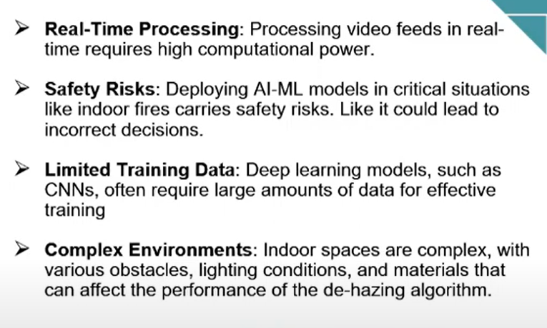
Idea Description

Slide 7
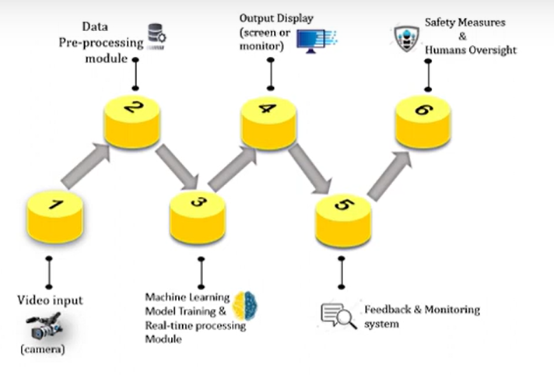
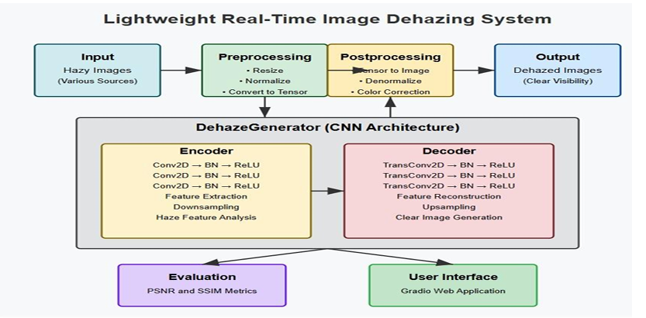
Architecture Diagram

Slide 8
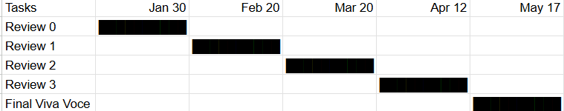
Timeline of Project

Slide 9
Conclusion
In this research, we have implemented an approach on single image dehazing via deep learning methods, and shows how deep learning can be used to remove haze from images using a custom CNN model. We trained the model on pairs of hazy and clear images so it could learn how to make hazy pictures look clean. After training and fine-tuning, the model was able to produce clearer and more detailed images. We also built a simple web app using Gradio that lets users upload hazy images and see the dehazed results instantly. The model gave good results based on quality checks like PSNR and SSIM, It was tested on different images and performed consistently in improving visibility and sharpness. The interface was easy to use and worked in real-time, making the project user-friendly. Through this project, valuable skills were gained in data preprocessing, deep learning model development, and deployment in a practical application. The ability to preserve image details and colors while removing haze opens potential use cases in fields like photography, surveillance, and outdoor navigation. The project proves that deep learning can effectively address real-world problems, offering an accessible solution to enhance image quality. With its user-friendly interface and solid performance, the project serves as a great example of leveraging AI to improve image clarity and make technology more accessible to users in various industries.

Slide 10
Github Link
The Github link provided should have public access permission.
https://github.com/Astaroth233/Image-Dehazing-using-AIML.git

Slide 11
References
[1]Achanta R, Hemami S, Estrada F, Susstrunk S (2009) Frequency-tuned salient region detection. In: IEEEconference on computer vision and pattern recognition, 2009. CVPR 2009. IEEE, pp 1597–1604
[2]Amintoosi M, Fathy M, Mozayani N (2011) Video enhancement through image registration based on structuralsimilarity. Imaging Sci J 59(4):238–250
[3]Ancuti CO, Ancuti C (2013) Single image dehazing by multi-scale fusion. IEEE Trans Image Process 22(8):3271–3282
[4]Ancuti CO, Ancuti C, Bekaert P (2010) Effective single image dehazing by fusion. In: 17th IEEE internationalconference on image processing (ICIP), 2010. IEEE, pp 3541–3544
[5]Ansari A, Danyali H, Helfroush MS (2017) Hs remote sensing image restoration using fusion with ms images byem algorithm. IET Signal Process 11(1):95–103

Slide 12
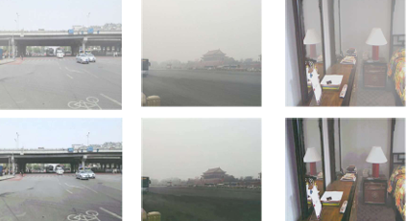
Results

Slide 13
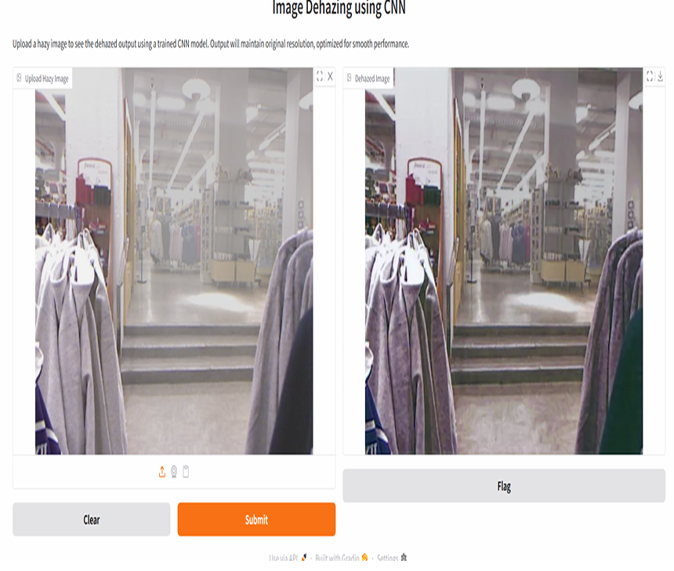
Results

Slide 14
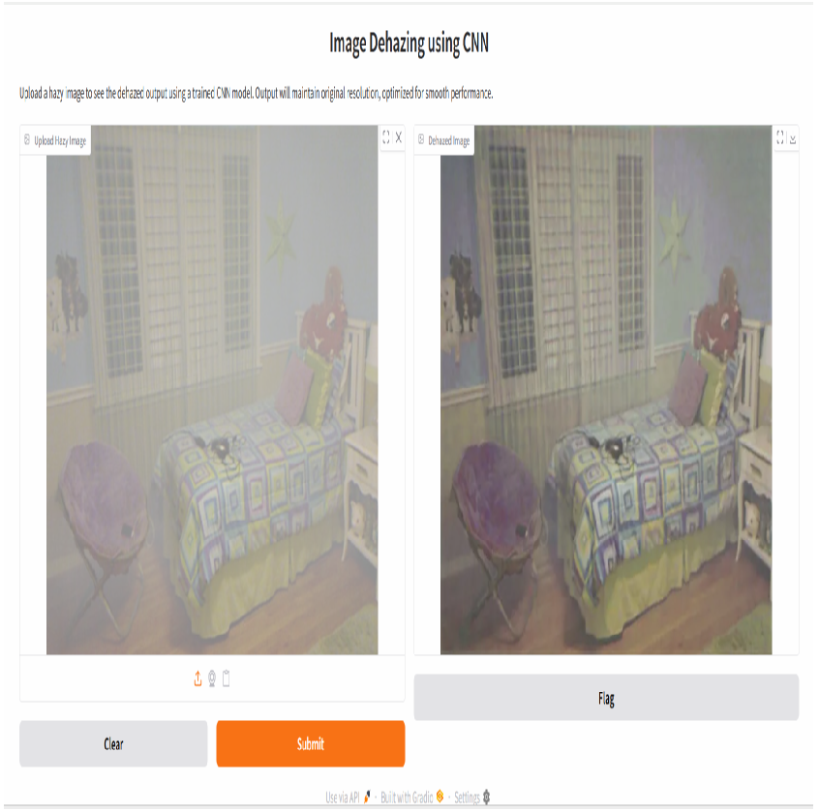
Results

Slide 15
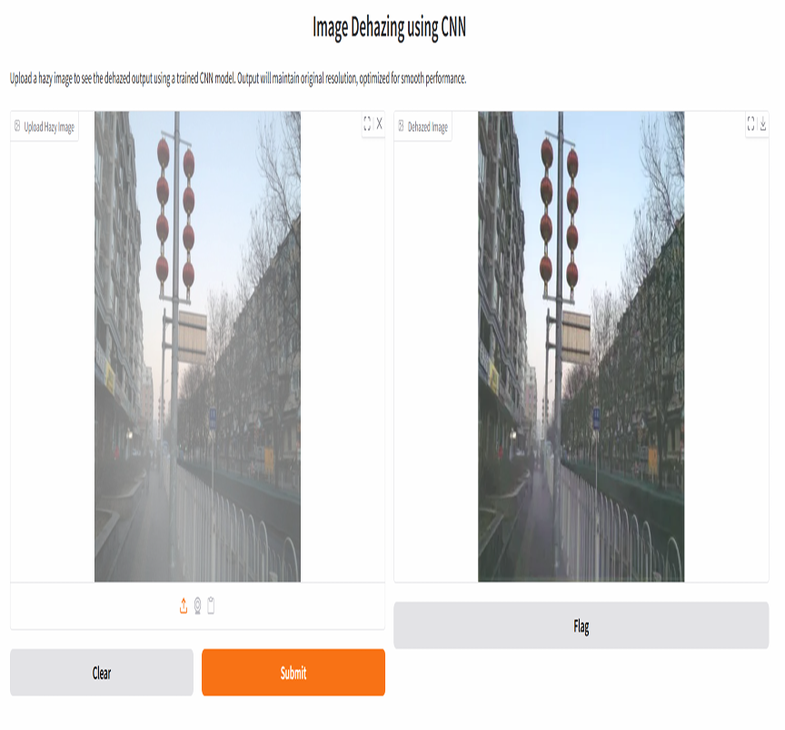
Results

Slide 16
Thank You

